Slide 1
社会媒体分析

Slide 2



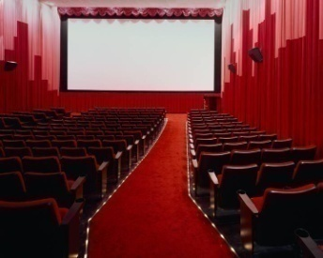


Traditional Media
Broadcast Media: One-to-Many
Communication Media: One-to-One

Slide 3












Social Media: Many-to-Many
Social Media
Social Networking
Blogs
Microblogging
Wiki
Forum
Content
Sharing
Notes:
There are various of social media: like social network , blogs, wiki, forums content sharing. Most of them are an open platform so users can connect with each other, generate content. These web 2.0 applications gained a lot of online traffic recently. They provide rich information about online users, also new tasks and challenges.

Slide 4
Various forms of Social Media
Blog: Wordpress, blogspot, LiveJournal
Forum: Yahoo! Answers, Epinions
Media Sharing: Flickr, YouTube, Scribd
Microblogging: Twitter, FourSquare
Social Networking: Facebook, LinkedIn, Orkut
Social Bookmarking: Del.icio.us, Diigo
Wikis: Wikipedia, scholarpedia, AskDrWiki

Slide 5

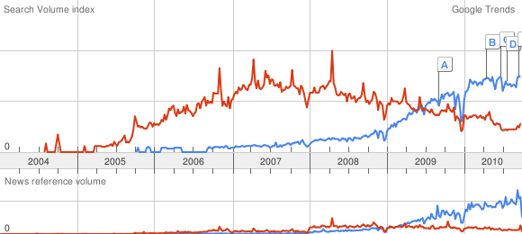

Slide 6
社会媒体内容分析包括
研究用户之间的关系
  社会网络 (social network)
研究用户之间+用户与信息之间的关系
  异构社会网络
研究社会网络的划分，网络领袖等
研究利用社会网络对社会媒体分析的帮助
  对媒体信息的聚类，标签推荐、产品推荐、广告发放等

Slide 7
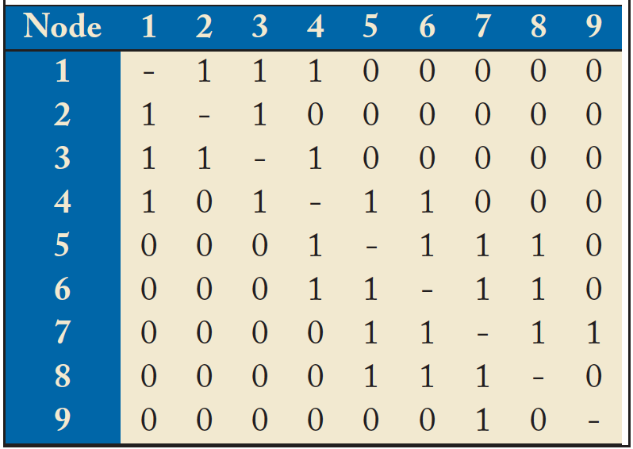
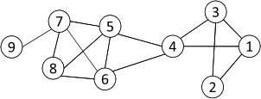
社会网络的表示
Social Network: A social structure made of nodes (individuals or organizations) and edges that connect nodes in various relationships like friendship, kinship etc.
Graph Representation
Matrix Representation

Slide 8
Basic Concepts
A: the adjacency matrix
V: the set of nodes
E: the set of edges
v_{i}: a node v_{i}
e(v_{i}, v_{j}): an edge between node v_{i} and v_{j}
N_{i}: the neighborhood of node v_{i}
d_{i}: the degree of node v_{i}
geodesic: a shortest path between two nodes
  geodesic distance

Slide 9
Properties of Large-Scale Networks
Networks in social media are typically huge, involving millions of actors and connections.
Large-scale networks in real world demonstrate similar patterns
  Scale-free distributions （power law)
  Small-world effect (the connection distance)
  Strong Community Structure

Slide 10
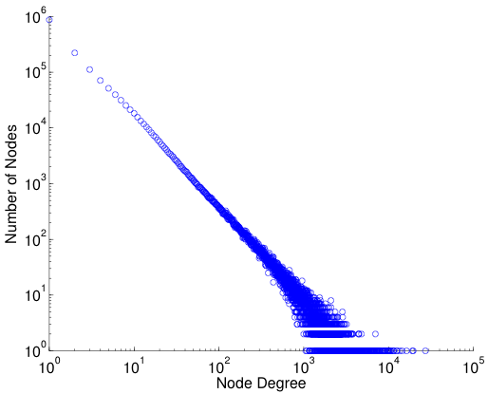
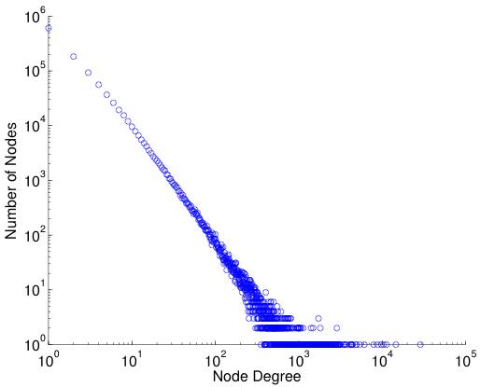
log-log plot
Power law distribution becomes a straight line if plot in a log-log scale
Friendship Network in Flickr
Friendship Network in YouTube

Slide 11
基本的测度
采用图论的测度
  直径，最短路
面向网络划分的测度
  社区发现
对网络中顶点和边的分析

Slide 12
Diameter
Measures used to calibrate the small world effect
  Diameter: the longest shortest path in a network
  Average shortest path length
The shortest path between two nodes is called geodesic.
The number of hops in the geodesic is the geodesic distance.
The geodesic distance between node 1 and node 9 is 4.
The diameter of the network is 5, corresponding to the geodesic distance between nodes 2 and 9.

Slide 13
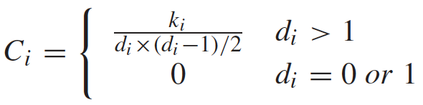
Community Structure
Community: People in a group interact with each other more frequently than those outside the group
Friends of a friend are likely to be friends as well
Measured by clustering coefficient:
  density of connections among one’s friends

Slide 14
Clustering Coefficient
k_{i}= the number of edges in the neighbor
d₆=4, N₆= {4, 5, 7,8}
k₆=4 as e(4,5), e(5,7), e(5,8), e(7,8)
C₆ = 4/(4*3/2) = 2/3
Average clustering coefficient
  C = (C₁ + C₂ + … + C_{n})/n
C = 0.61 for the left network
In a random graph, the expected coefficient is 14/(9*8/2) = 0.19.

Slide 15
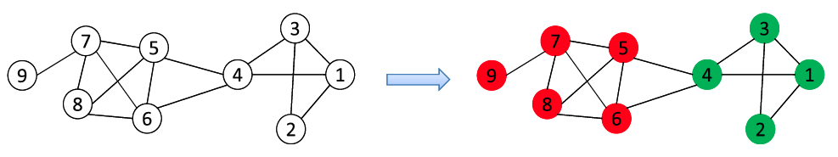
Community Detection
A community is a set of nodes between which the interactions are (relatively) frequent
  A.k.a., group, cluster, cohesive subgroups, modules
Applications: Recommendation based communities, Network Compression, Visualization of a huge network
New lines of research in social media
  Community Detection in Heterogeneous Networks
  Community Evolution in Dynamic Networks
  Scalable Community Detection in Large-Scale Networks

Slide 16
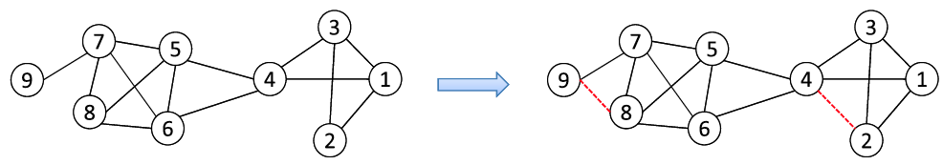
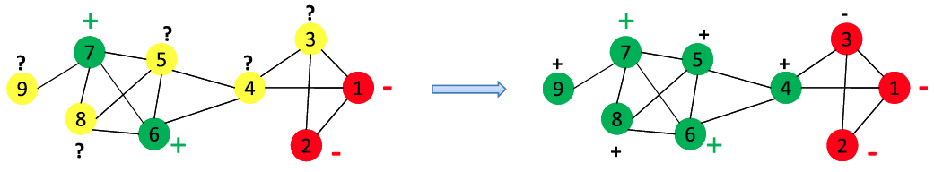
Classification and Recommendation
Common in social media applications
  Tag suggestion, Friend/Group Recommendation, Targeting
Link prediction
Network-Based Classification

Slide 17


Degree Centrality(distance=1)
The importance of a node is determined by the number of nodes adjacent to it
  The larger the degree, the more import the node is
  Only a small number of nodes have high degrees in many real-life networks
Degree Centrality
Normalized Degree Centrality:
For node 1, degree centrality is 3;
Normalized degree centrality is
3/(9-1)=3/8.
Notes:
“A small number of nodes have high degrees” thanks to the power law

Slide 18

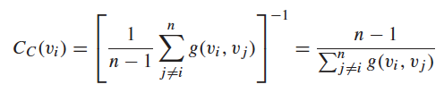
Closeness Centrality (distance>1)
“Central” nodes are important, as they can reach the whole network more quickly than non-central nodes
Importance measured by how close a node is to other nodes
Average Distance:
Closeness Centrality （越大越好）

Slide 19
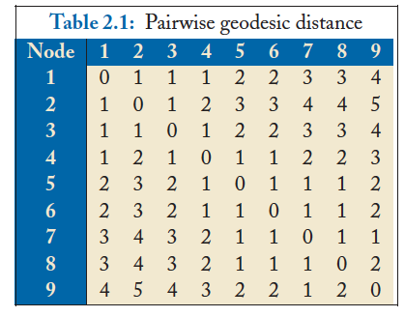
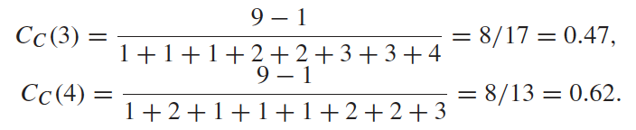
Closeness Centrality Example
Node 4 is more central than node 3

Slide 20


Betweenness Centrality
Node betweenness counts the number of shortest paths that pass one node (the role of a vertex in graph connectitivity)
Nodes with high betweenness are important in communication and information diffusion
Betweenness Centrality
The number of shortest paths between s and t
The number of shortest paths between s and t that pass v_{i}

Slide 21
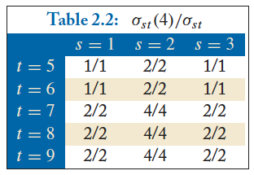

Betweenness Centrality Example
What’s the betweenness centrality for node 5?
The number of shortest paths between s and t
The number of shortest paths between s and t that pass v_{i}
越大说明该节点越重要

Slide 22
Weak and Strong Ties
In practice, connections are not of the same strength
Interpersonal social networks are composed of strong ties (close friends) and weak ties (acquaintances 简单相识).
Strong ties and weak ties play different roles for community formation and information diffusion
Strength of Weak Ties (Granovetter, 1973)
  Occasional encounters with distant acquaintances can provide important information about new opportunities for job search

Slide 23
Connections in Social Media
  Social Media allows users to connect to each other more easily than ever
    One user might have thousands of friends online
    Who are the most important ones among your 300 Facebook friends?
  Imperative to estimate the strengths of ties for advanced analysis
    Analyze network topology
    Learn from User Profiles and Attributes
    Learn from User Activities

Slide 24
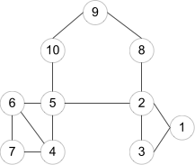

Learning from Network Topology
Bridges connecting two different communities are weak ties
An edge is a bridge if its removal results in disconnection of its terminal nodes
  e(2,5) is a bridge
  e(2,5) is NOT a bridge

Slide 25
“shortcut” Bridge
Bridges are rare in real-life networks
Alternatively, one can relax the definition by checking if the distance between two terminal nodes increases if the edge is removed
The larger the distance, the weaker the tie is
d(2,5) = 4 if e(2,5) is removed
d(5,6) = 2 if e(5,6) is removed
e(5,6) is a stronger tie than e(2,5)

Slide 26
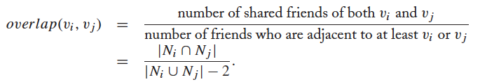

Neighborhood Overlap （评估2点之间的紧密程度）
Tie Strength can be measured based on neighborhood overlap; the larger the overlap, the stronger the tie is.
-2 in the denominator is to exclude v_{i} and v_{j}

Slide 27
Learning from Profiles and Interactions
Twitter: one can follow others without followee’s confirmation
  The real friendship network is determined by the frequency two users talk to each other, rather than the follower-followee network
  The real friendship network is more influential in driving Twitter usage
Strengths of ties can be predicted accurately based on various information from Facebook
  Friend-initiated posts, message exchanged in wall post, number of mutual friends, etc.
Learning numeric link strength by maximum likelihood estimation
  User profile similarity determines the strength
  Link strength in turn determines user interaction
  Maximize the likelihood based on observed profiles and interactions

Slide 28
Learning from User Activities
One might learn how one influences his friends if the user activity log is accessible
Depending on the adopted influence model
  Independent cascading model （独立级联模型）
  Linear threshold model （线性阈值模型）
Maximizing the likelihood of user activity given an influence model

Slide 29
Influence modeling
Influence modeling is one of the fundamental questions in order to understand the information diffusion, spread of new ideas, and word-of-mouth (viral) marketing
Well known Influence modeling methods
  Linear threshold model (LTM)
  Independent cascade model (ICM)

Slide 30
Common properties of Influence modeling methods
A social network is represented a directed graph, with each actor being one node;
Each node is started as active or inactive;
A node, once activated, will activate his neighboring nodes;
Once a node is activated, this node cannot be deactivated.

Slide 31
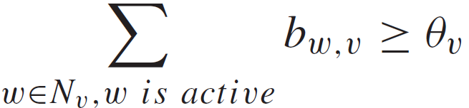
Linear Threshold Model
An actor would take an action if the number of his friends who have taken the action exceeds (reaches) a certain threshold
Each node v chooses a threshold ϴ_{v} randomly from a uniform distribution in an interval between 0 and 1.
In each discrete step, all nodes that were active in the previous step remain active
The nodes satisfying the following condition will be activated

Slide 32
B_{w,v} is the strength that node w can influence node v, usually we can define
K_{v} is the number of the neighbors -1

Slide 33
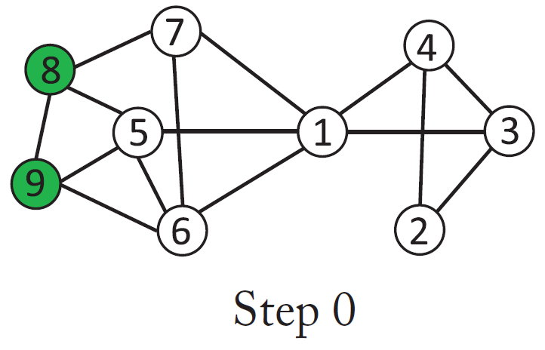
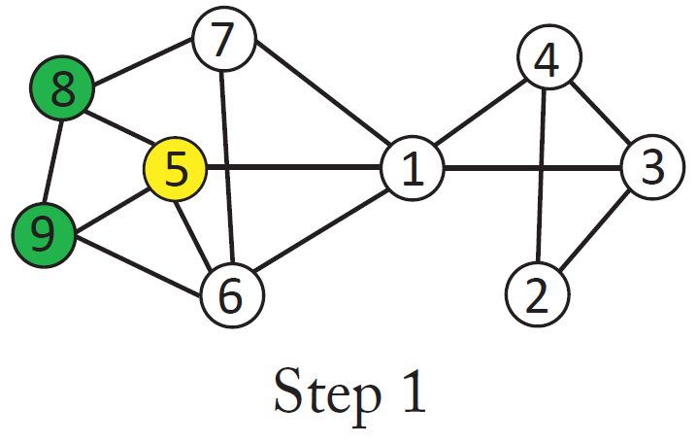
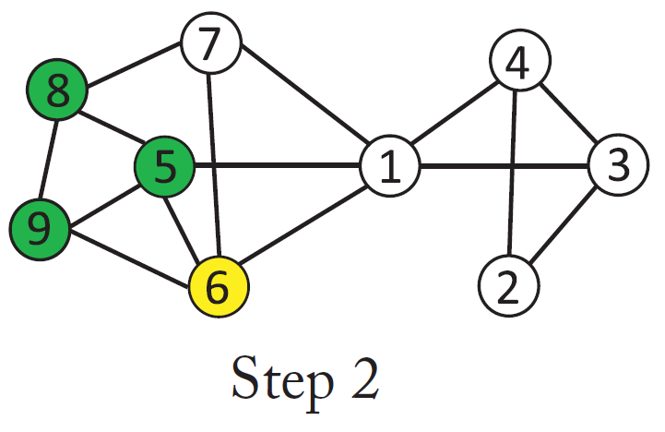
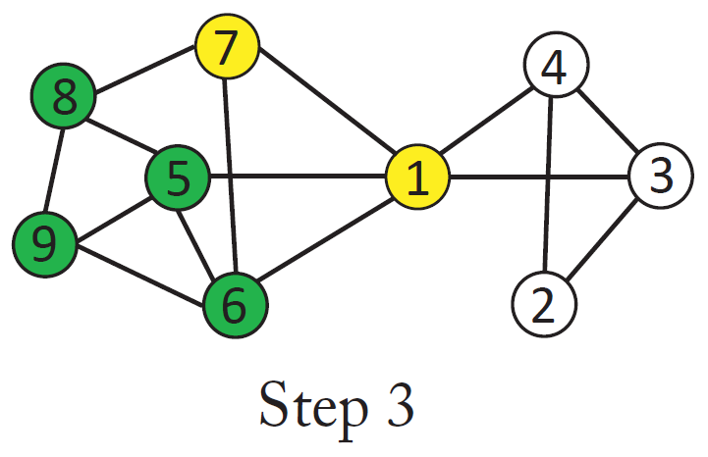
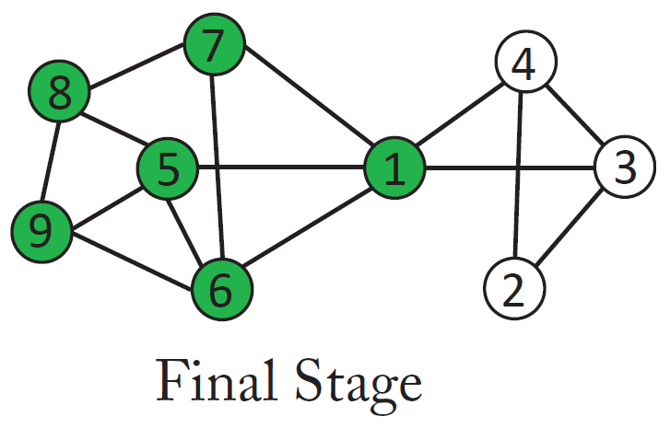
Linear Threshold Model- Diffusion Process (Threshold = 50%)

Slide 34
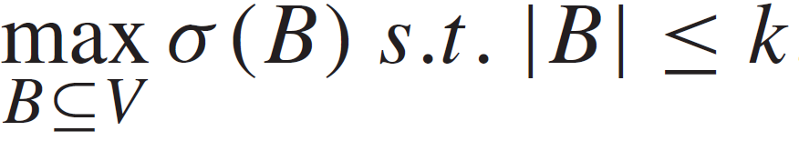
Influence Maximization
Given a network and a parameter k, which k nodes should be selected to be in the activation set B in order to maximize the influence in terms of active nodes at the end? （如何选择初始的k个顶点？）
Let σ(B) denote the expected number of nodes that can be influenced by B, the optimization problem can be formulated as follows:

Slide 35
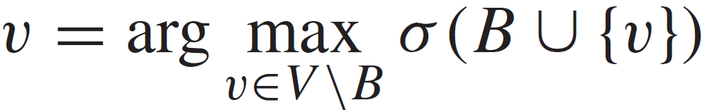
Influence Maximization- A greedy approach
Maximizing the influence, is a NP-hard problem but it is proved that the greedy approaches gives a solution that is 63 % of the optimal.
A greedy approach:
  Start with B = Ø
  Evaluate σ(v) for each node, and pick the node with maximum σ as the first node v1 to form B = {v1}
  Select a node which will increase σ(B) most if the node is included in B.
Essentially, we greedily find a node v ∈ V \B such that

Slide 36
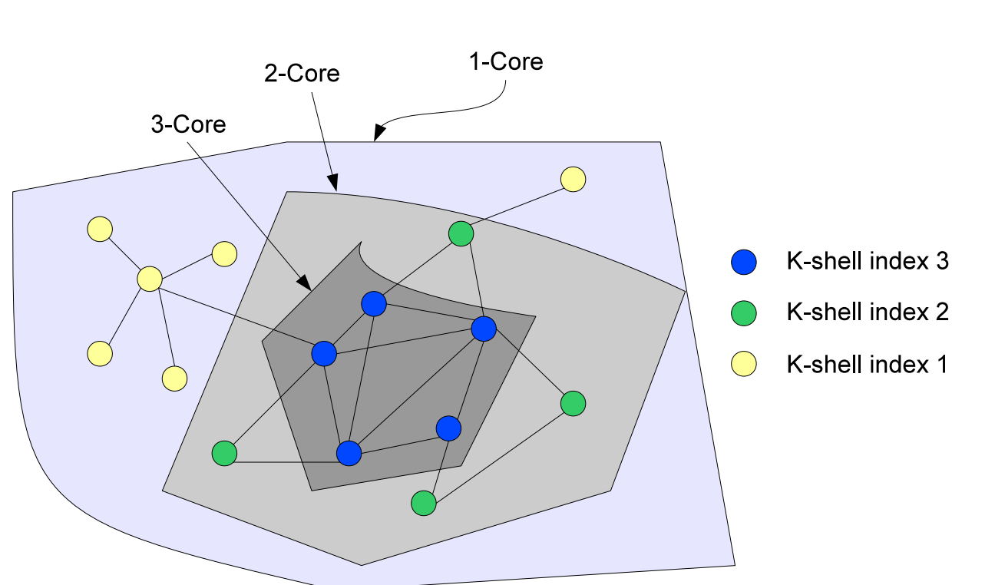
K-shell method

Slide 37
Community Detection and Evaluation

Slide 38
Community
Community: It is formed by individuals such that those within a group interact with each other more frequently than with those outside the group
  a.k.a. group, cluster, cohesive subgroup, module in different contexts
Community detection: discovering groups in a network where individuals’ group memberships are not explicitly given
Why communities in social media?
  Human beings are social
  Easy-to-use social media allows people to extend their social life in unprecedented ways
  Difficult to meet friends in the physical world, but much easier to find friend online with similar interests
  Interactions between nodes can help determine communities
Notes:
The categorization are not necessarily disjoint
; social media is becoming an aspect of the physical world

Slide 39
Communities in Social Media
Two types of groups in social media
  Explicit Groups: formed by user subscriptions
  Implicit Groups: implicitly formed by social interactions
Some social media sites allow people to join groups, is it necessary to extract groups based on network topology?
  Not all sites provide community platform
  Not all people want to make effort to join groups
  Groups can change dynamically
Network interaction provides rich information about the relationship between users
  Can complement other kinds of information
  Help network visualization and navigation
  Provide basic information for other tasks
Notes:
Groups are not active: the group members seldom talk to each other
Explicitly vs. implicitly formed groups

Slide 40
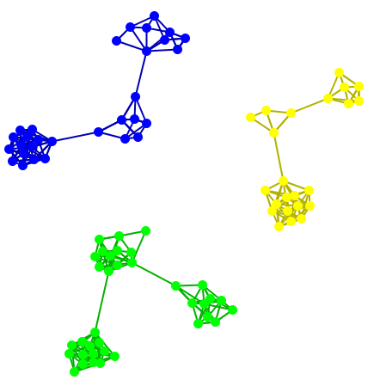
Subjectivity of Community Definition
Each component is a community
A densely-knit community
Definition of a community
can be subjective.
Notes:
No objective definition for a community
Visualization might help, but only for small networks
Real-world networks tend to be noisy
Need a proper criteria

Slide 41
Taxonomy of Community Criteria
Criteria vary depending on the tasks
Roughly, community detection methods can be divided into 4 categories (not exclusive):
Node-Centric Community
  Each node in a group satisfies certain properties
Group-Centric Community
  Consider the connections within a group as a whole. The group has to satisfy certain properties without zooming into node-level
Network-Centric Community
  Partition the whole network into several disjoint sets
Hierarchy-Centric Community
  Construct a hierarchical structure of communities

Slide 42
Node-Centric Community Detection
Nodes satisfy different properties
  Complete Mutuality （密切关系）
    cliques
  Reachability of members （满足可达性）
    k-clique, k-clan, k-club
  Nodal degrees
    k-plex, k-core
  Relative frequency of Within-Outside Ties
    LS sets, Lambda sets
Commonly used in traditional social network analysis
Here, we discuss some representative ones

Slide 43
Complete Mutuality: Cliques
Clique: a maximum complete subgraph in which all nodes are adjacent to each other
NP-hard to find the maximum clique in a network
Straightforward implementation to find cliques is very expensive in time complexity
Nodes 5, 6, 7 and 8 form a clique

Slide 44
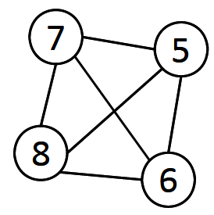
Maximum Clique Example
Suppose we sample a sub-network with nodes {1-5} and find a clique {1, 2, 3} of size 3
In order to find a clique >3, remove all nodes with degree <=3-1=2
  Remove nodes 2 and 9
  Remove nodes 1 and 3
  Remove node 4

Slide 45
Clique Percolation (浸透） Method (CPM)
Clique is a very strict definition, unstable
Normally use cliques as a core or a seed to find larger communities
CPM is such a method to find overlapping communities
  Input
    A parameter k, and a network
  Procedure
    Find out all cliques of size k in a given network
    Construct a clique graph. Two cliques are adjacent if they share k-1 nodes
    Each connected components in the clique graph form a community

Slide 46
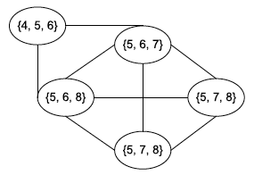

CPM Example
Cliques of size 3:
{1, 2, 3}, {1, 3, 4}, {4, 5, 6}, {5, 6, 7}, {5, 6, 8}, {5, 7, 8},
{6, 7, 8}
Communities:
{1, 2, 3, 4}
{4, 5, 6, 7, 8}

Slide 47
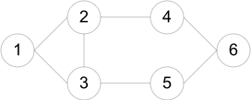
Reachability : k-clique, k-club
Any node in a group should be reachable in k hops (距离≤k)
k-clique: a maximal subgraph in which the largest geodesic distance between any two pairs of nodes <= k
A k-clique might have diameter larger than k in the subgraph (e.g 4,5 in the first 2-clique. )
Commonly used in traditional SNA
Often involves combinatorial optimization
Cliques: {1, 2, 3}
2-cliques: {1, 2, 3, 4, 5}, {2, 3, 4, 5, 6}
2-clubs: {1,2,3,4}, {1, 2, 3, 5}, {2, 3, 4, 5, 6}

Slide 48
K-Club
k-club : A subgraph C, ∀u,v ∈ C, d(u,v) ≤k. The definition of k-club is more strict than that of k-clique. A k-club is often a subset of a k-clique. In the example in Figure 3.2, The 2-clique structure {1, 2, 3, 4, 5} contains two 2-clubs, {1, 2, 3, 4} and {1, 2, 3, 5}.

Slide 49

Group-Centric Community Detection: Density-Based Groups
The group-centric criterion requires the whole group to satisfy a certain condition
  E.g., the group density >= a given threshold
A subgraph is a quasi-clique if
A similar strategy to that of cliques can be used
  Sample a subgraph, and find a maximal quasi-clique (say, of size k)
  Remove nodes with degree

Slide 50
Network-Centric Community Detection
Network-centric criterion needs to consider the connections within a network globally
Goal: partition nodes of a network into disjoint sets
Approaches:
  Clustering based on vertex similarity
  Latent space models
  Block model approximation
  Spectral clustering
  Minimum Cut
Notes:
A typical goal is to partition a network into disjoint sets. But that can be extended to soft clustering as well

Slide 51
Clustering based on Vertex Similarity
Apply k-means or similarity-based clustering to nodes
Vertex similarity is defined in terms of the similarity of their neighborhood
Structural equivalence: two nodes are structurally equivalent iff they are connecting to the same set of actors
Structural equivalence is too restrict for practical use.
Nodes 1 and 3 are structurally equivalent;
So are nodes 5 and 7.

Slide 52
Clustering based on Vertex Similarity
Apply k-means or similarity-based clustering to nodes
Vertex similarity is defined in terms of the similarity of their neighborhood
Structural equivalence: two nodes are structurally equivalent iff they are connecting to the same set of actors
Structural equivalence is too restrict for practical use.
Nodes 1 and 3 are structurally equivalent;
So are nodes 5 and 7.

Slide 53




Vertex Similarity
Jaccard Similarity
Cosine similarity

